Slide 1
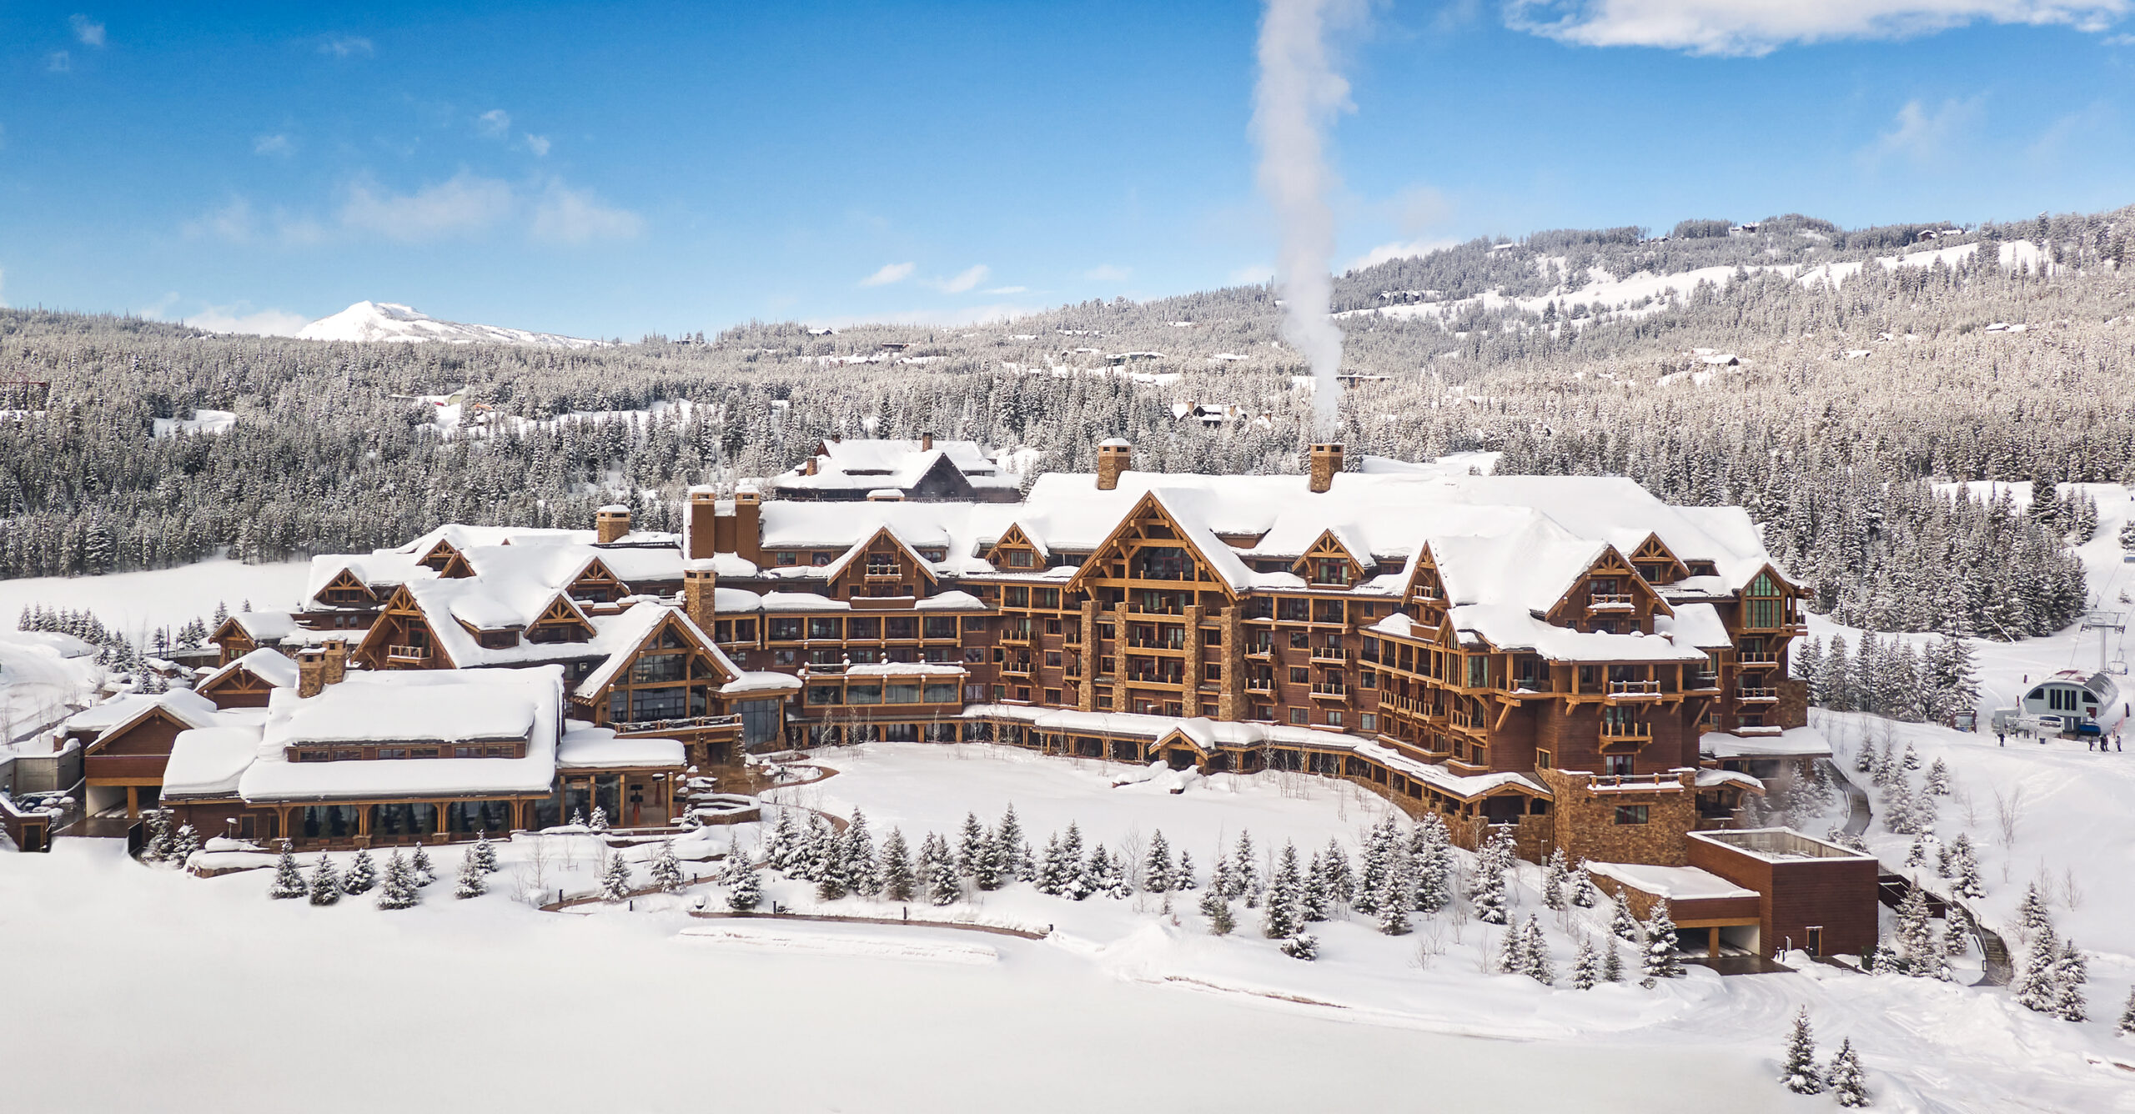
Big Mountain Resort

Slide 2
Problem Identification: What opportunities exist for Big Mountain Resort to effectively develop a new pricing strategy that can maximize capitalization in their facilities investments to offset their recent additional operating cost by $1,540,000 this season.

Slide 3
Key findings and Recommendations: 1. Permanently shut down up to 6 (Closing down 6 or more leads to a large drop) of the least used runs. This doesn't impact any other resort statistics. 2. Increasing the vertical drop by 150 feet, and installing an additional chair lift this scenario leads to ticket price increase by $11.74 over the season predicted amount of $20,542,614. 3. Adding two acres of snow making could boost the ticket price up to $13.51 over the season predicted amount of $23,644,886.

Slide 4
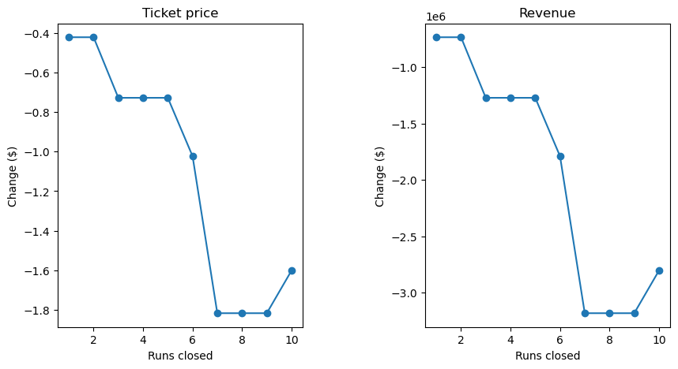
Modeling results and Analysis:
Permanently close to 6 of the least used runs will not impact any resort statics.

Slide 5
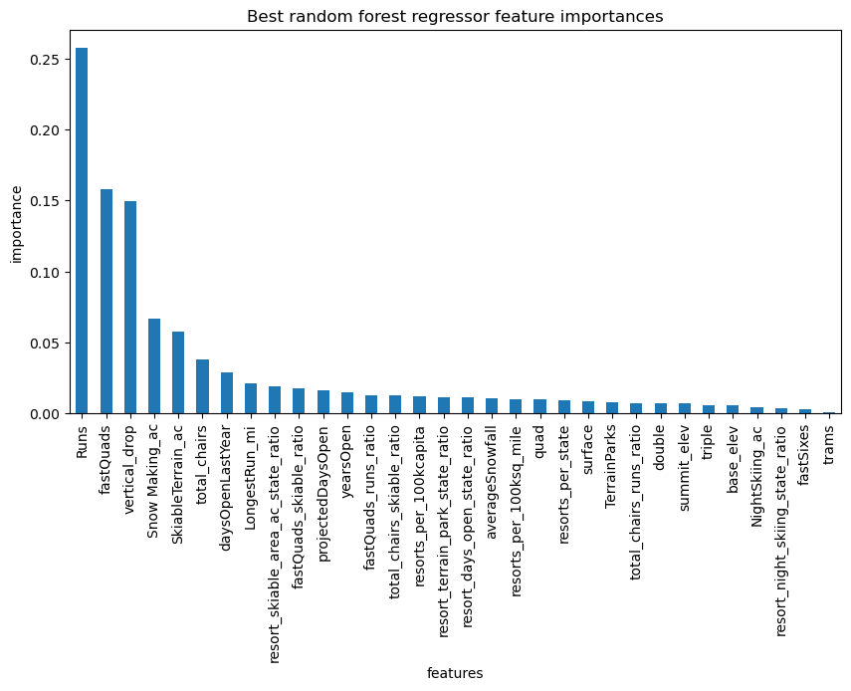
Best random forest regressor feature importance.
The regressor shows The Big Mountain Resort top three features Runs, Fast Quads, and Vertical drop.

Slide 6
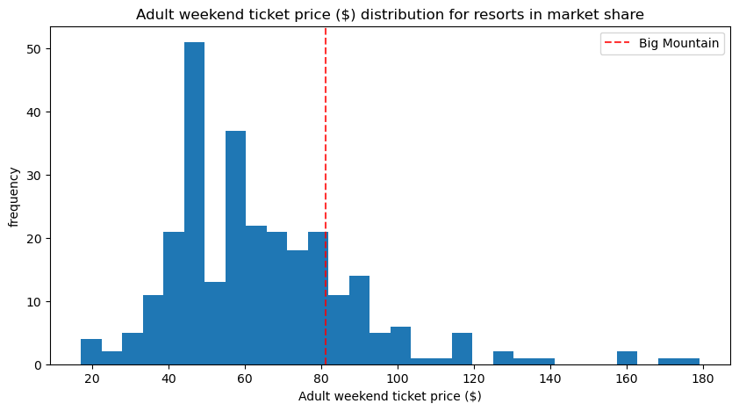
Adult weekend ticket price distribution in market share.

Slide 7
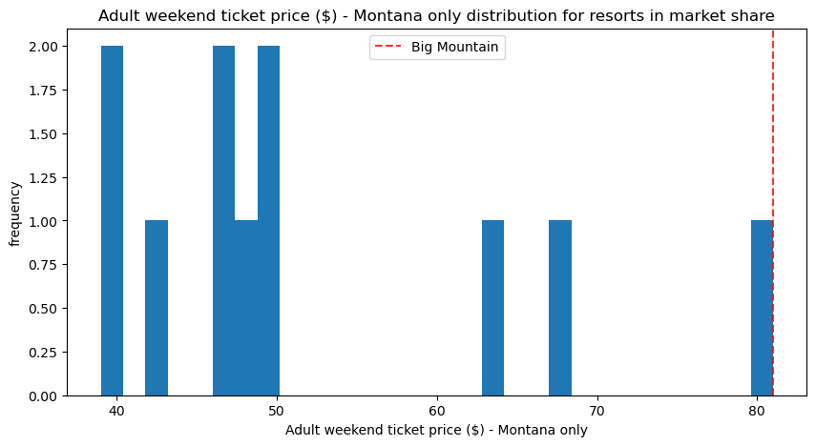
Adult weekend ticket price Montana only distribution for resorts in market share.

Slide 8
Summary:
In modeling our data shows Permanente close to up to 6 (Closing down 6 or
more leads to a large drop) of the least used runs. This doesn't impact any other resort
statistics.
Increasing the vertical drop by 150 feet, and installing an additional chair lift this
scenario leads to ticket price increase by $11.74 over the season predicted amount of
$20,542,614.
Adding two acres of snow making could boost the ticket price up to $13.51 over the
season predicted amount of $23,644,886.

Slide 9
Conclusion:
In conclusion we see that we can reduce The Big Mountain Resort operations cost by closing some of the least used runs. In addition to the cost reduction, we have room for ticket price increase as our data modeling showed us.

